Slide 1

Тема: VIP visit to my company.
MOSCOW REGIONAL BRANCH
PREPARED: Podstrechnyy A.V. – 1E2
CHECKED: English teacher Gonchar. A.E.

Slide 2

Content
Places to visit
Staff to meet guests
The place for staying
Transport for move around
Farewell event
Gifts for visitors
Other factors of meeting

Slide 3
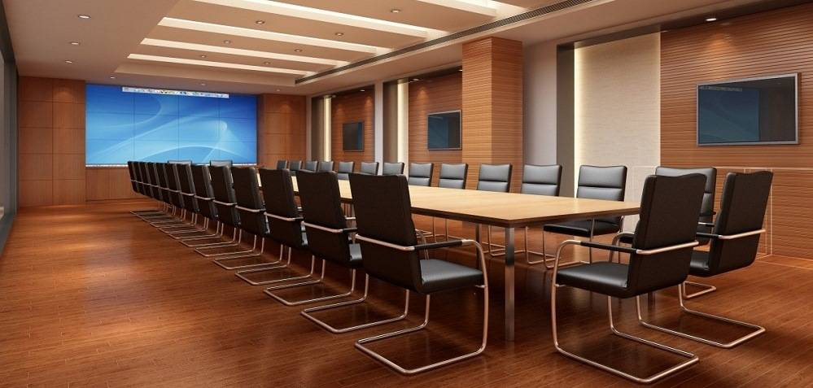
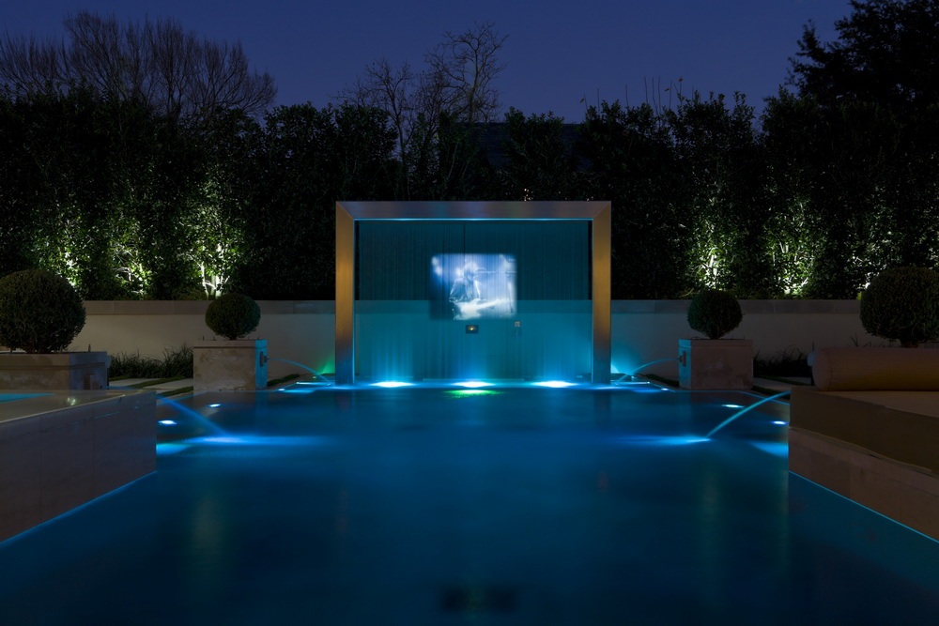
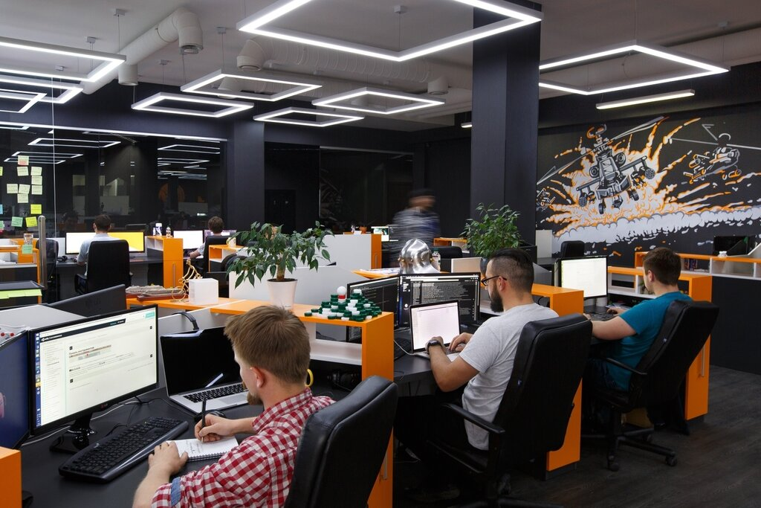
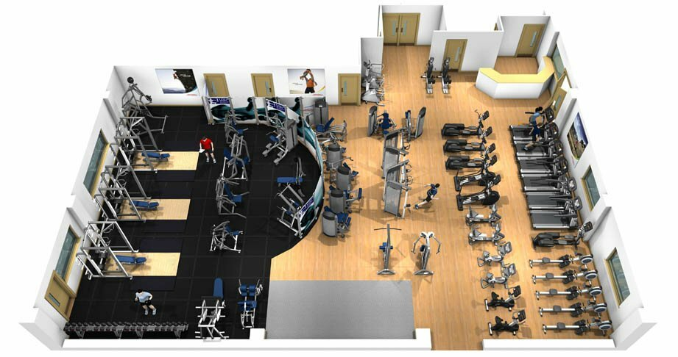
Places to visit
In my opinion, the first place VIPs should visit is the main software development room, where the main workforce of my company works. Next, we can suggest that the guests of honor walk to our attractions - an artificial hi-tech fountain, a fitness room, and a small exhibition of our products.

Slide 4


Staff to meet guests
VIP guests need to meet with the company's top management and department heads.

Slide 5

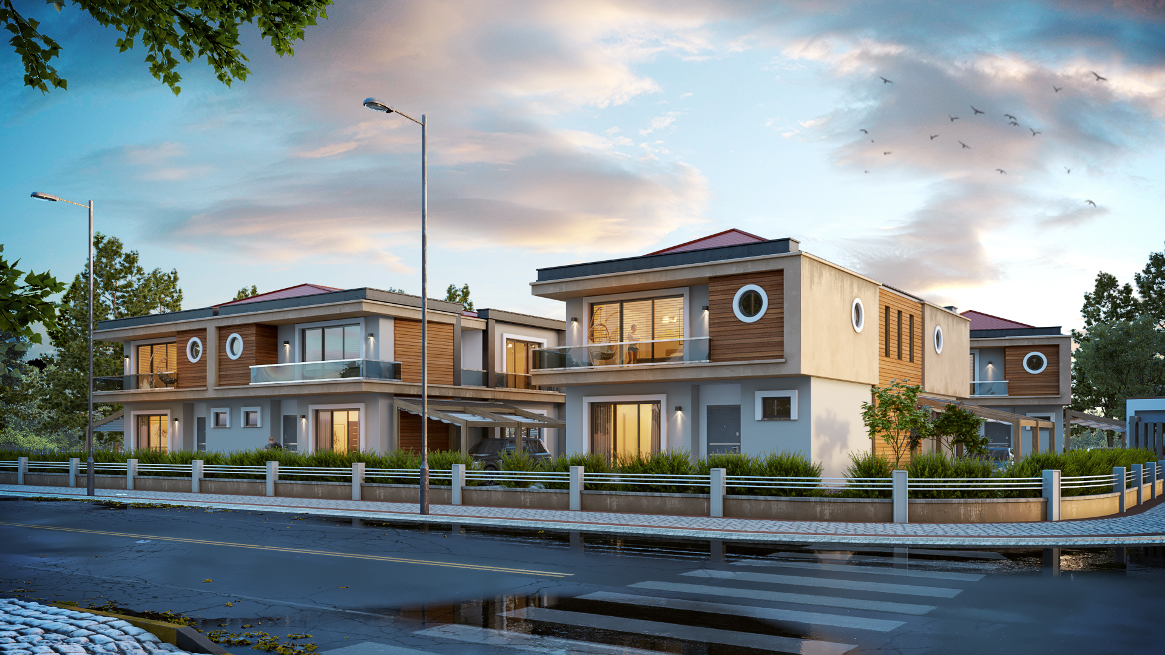
The place for staying
Our company owns a small cottage town to live in. It is located in a small distance from the company itself, among nature and beautiful scenery. There are several houses especially for VIP guests and management personnel.

Slide 6
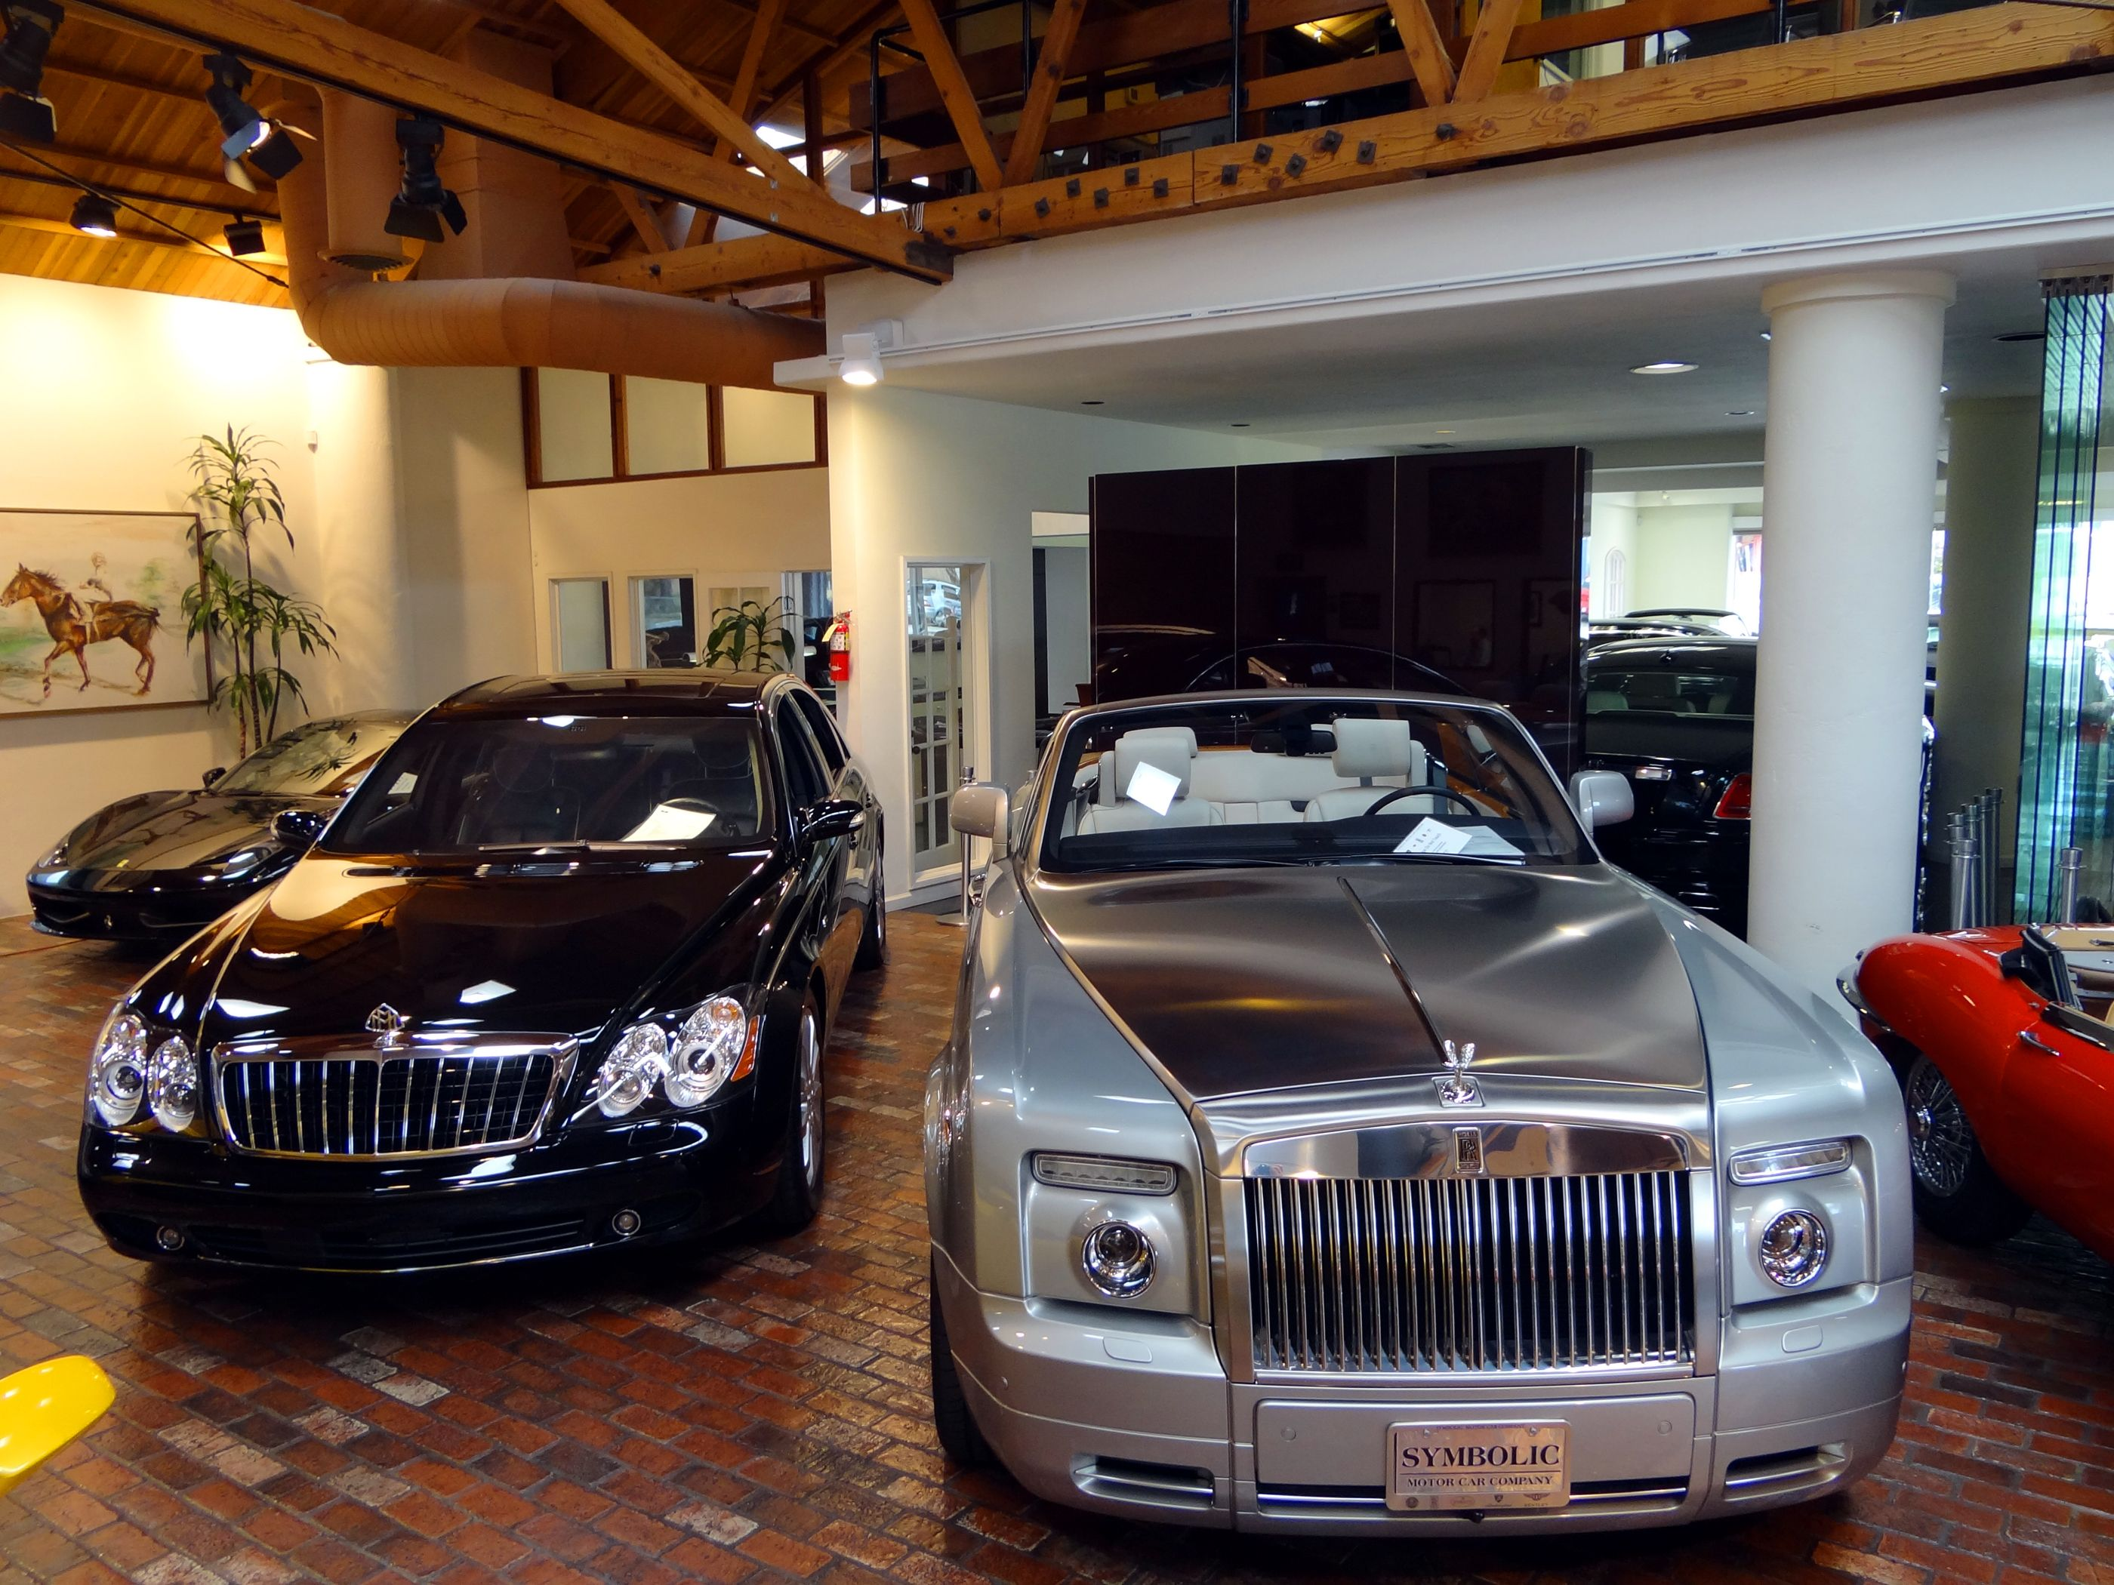
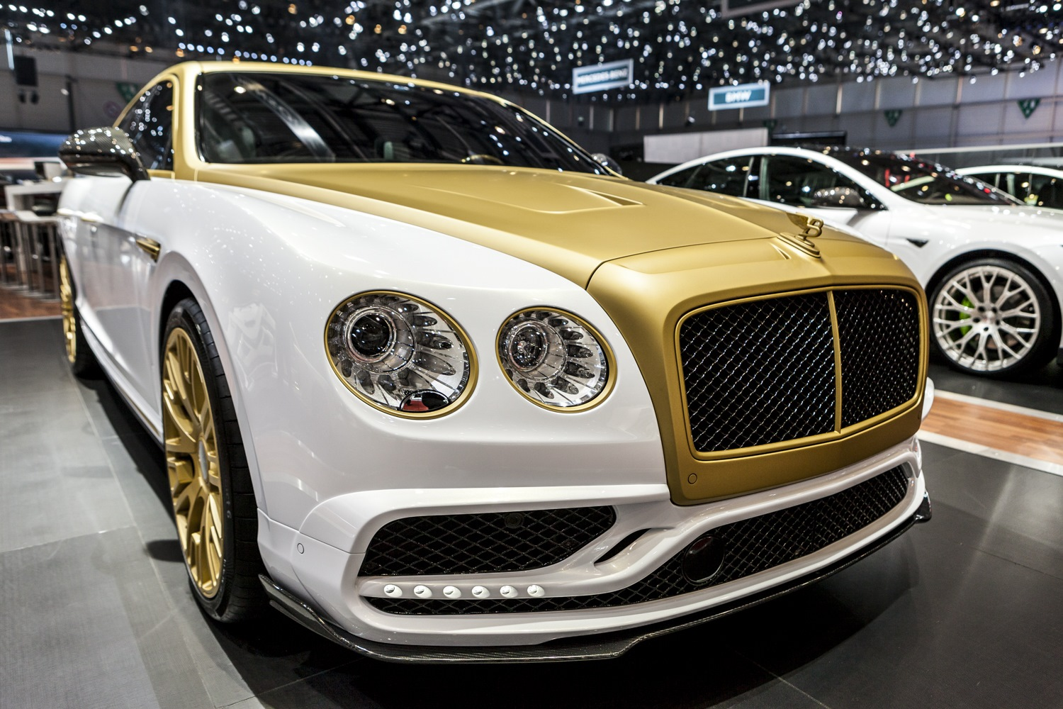
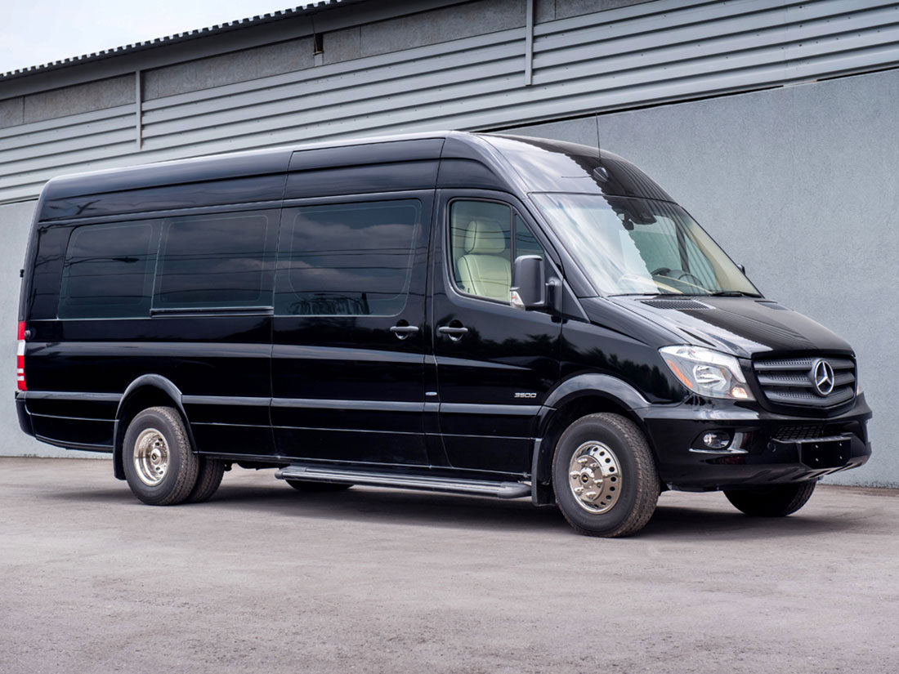
Transport for move around
In the cottage town, as in the main building of our company, there is a separate building-garage for cars. It is used to park both personal cars of the workforce and company-owned vehicles. The VIP class car park includes five Bentley cars, five Rolls-Royce cars, many cars and buses from Mercedes Benz, Chevrolet, Lincoln and others. According to the wishes of our guests will be selected the best car or bus available.

Slide 7
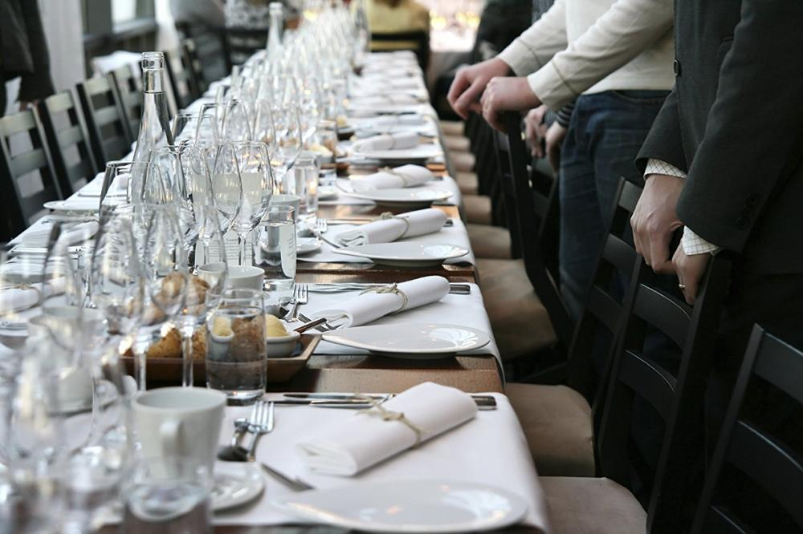
Farewell event
The farewell event will be an honorary dinner hosted by internationally renowned chefs. A buffet and dinner are planned. The guests of honor will be served hors d'oeuvres.
Also I, as the founder of the company, will make a solemn speech, in which the management of our company will say goodbye to the VIP guests.
The ceremony will be attended by VIP guests and other executives of our company. There will be service personnel throughout the entire farewell dinner.
As entertainment, we will offer our guests to become the first testers of our unique software product - interaction with several humanoid robots created by our company based on artificial intelligence technology.

Slide 8
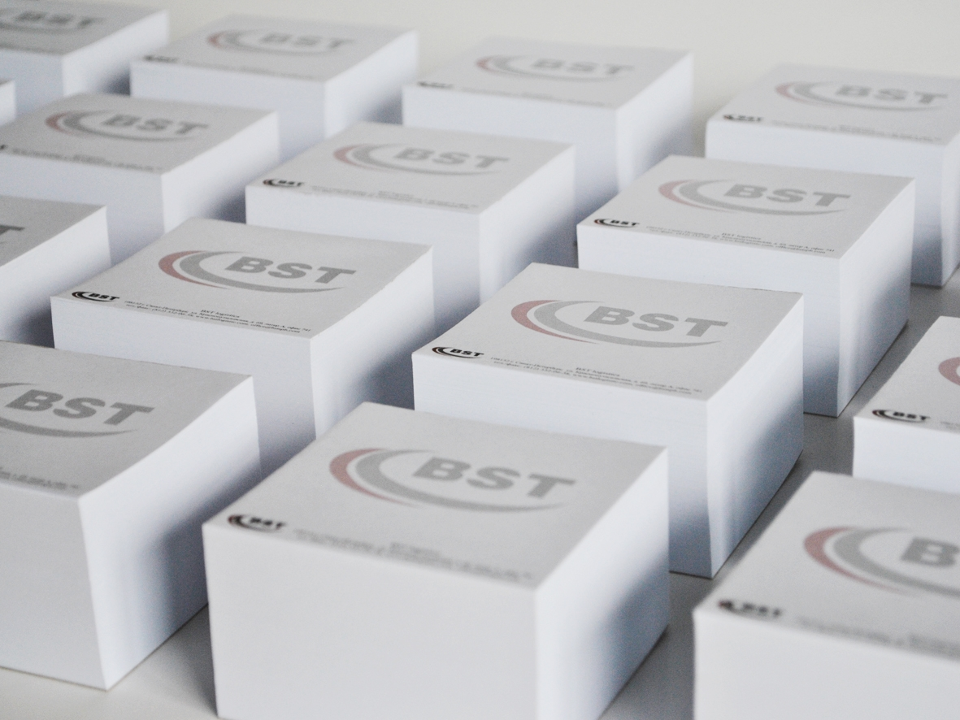

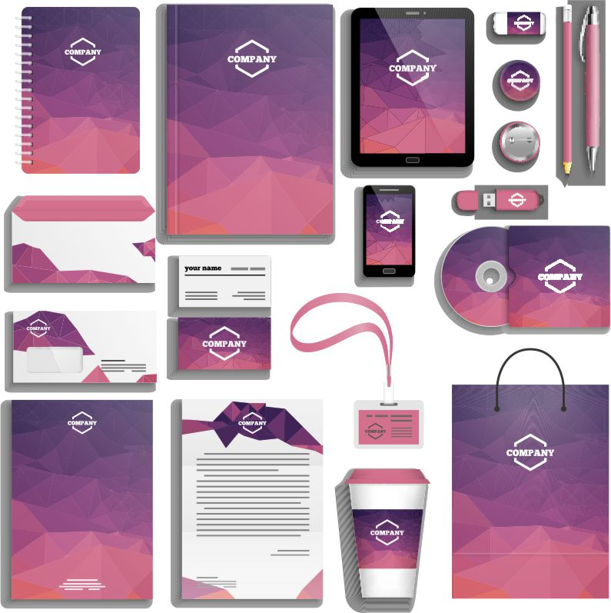
Gifts for visitors
Throughout the visit, our VIP guests will be able to get free branded clothing from our company, key chains, and much more. The main gift will be a pass for a year of free use of our artificial intelligence technology.

Slide 9
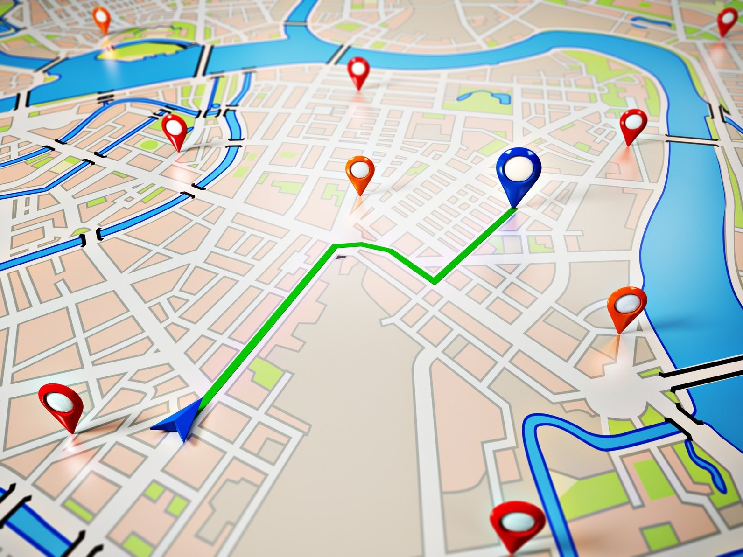

Other factors of meeting
So we need to plan the march of visits, the organization of various formal and business meetings, various timings down to the minute and other factors of our meeting, so that our honored guests were not bored and got a lot of positive emotions after visiting our company.

Slide 10
Thank you for attention!

